Slide 1

UNIVERSITY INSTITUTE OF ENGINEERING
DEPARTMENT OF COMPUTER SCIENCE & ENGINEERING
Master of Engineering (Computer Science & Engineering)
Subject Name : Soft Computing
Department: CSE
Prepared By: Er. Komal Sharma.
DISCOVER . LEARN . EMPOWER

Slide 2
COURSE DESCRIPTION
Soft Comtuting is everywhere.
An umbrella term used to describe types of algorithms that produce approximate solutions to unsolvable high-level problems in computer science.

Slide 3
COURSE OBJECTIVES
To understand soft computing concepts and techniques
To foster their abilities in designing and implementing soft computing based solutions for real-world and engineering problems.
To Introduce students to fuzzy systems, fuzzy logic and its applications.
To Provide the mathematical background for carrying out the optimization associated with neural network learning.

Slide 4
COURSE OUTCOMES
On completion of this course, the students are expected to have learnt about the following:
C01 | Describe familiarity with the basic concepts related to soft computing
CO2 | Illustrate various fuzzy lgic functions
CO3 | Analyze numerous artificial neural network types
CO4 | Outline fundamental concepts of genetic algorithms in machine learning
CO5 | Develop hybrid nature of FIS techniques to real world problems by extending the capabilities of existing technology

Slide 5
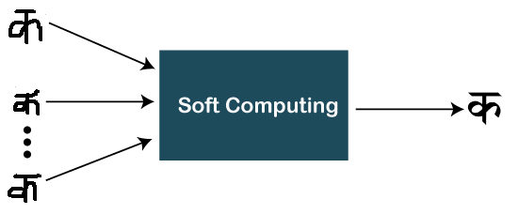
Chapter 1.1
Introduction to Soft Computing:
What is soft computing?
Note: Basically, soft computing is different from traditional/conventional computing and it deals with approximation models.

Slide 6
Chapter 1.1
Soft Computing:
What is Soft Computing?
Soft computing is the reverse of hard (conventional) computing. It refers to a group of computational techniques that are based on artificial intelligence (AI) and natural selection. It provides cost-effective solutions to the complex real-life problems for which hard computing solution does not exist.
Zadeh coined the term of soft computing in 1992. The objective of soft computing is to provide precise approximation and quick solutions for complex real-life problems.

Slide 7
Chapter 1.1
Some characteristics of Soft computing
Soft computing provides an approximate but precise solution for real-life problems.
The algorithms of soft computing are adaptive, so the current process is not affected by any kind of change in the environment.
The concept of soft computing is based on learning from experimental data. It means that soft computing does not require any mathematical model to solve the problem.
Soft computing helps users to solve real-world problems by providing approximate results that conventional and analytical models cannot solve.
It is based on Fuzzy logic, genetic algorithms, machine learning, ANN, and expert systems.

Slide 8
Chapter 1.1
Example
Soft computing deals with the approximation model. Yoi will understand with the help of examples of how it deals with the approximation model.
Let's consider a problem that actually does not have any solution via traditional computing, but soft computing gives the approximate solution.
string1 = "xyz" and string2 = "xyw"
Problem 1
Are string1 and string2 same?
Solution
No, the solution is simply No. It does not require any algorithm to analyze this.
Let's modify the problem a bit.
Problem 2
How much string1 and string2 are same?
Solution
Through conventional programming, either the answer is Yes or No. But these strings might be 80% similar according to soft computing.
You have noticed that soft computing gave us the approximate solution.

Slide 9
Chapter 1.1
Applications of soft computing
There are several applications of soft computing where it is used. Some of them are listed below:
It is widely used in gaming products like Poker and Checker.
In kitchen appliances, such as Microwave and Rice cooker.
In most used home appliances - Washing Machine, Heater, Refrigerator, and AC as well.
Apart from all these usages, it is also used in Robotics work (Emotional per Robot form).
Image processing and Data compression are also popular applications of soft computing.
Used for handwriting recognition.
As we already said that, soft computing provides the solution to real-time problems and here you can see that. Besides these applications, there are many other applications of soft computing.

Slide 10
Chapter 1.1
Need of soft computing
Sometimes, conventional computing or analytical models does not provide a solution to some real-world problems. In that case, we require other technique like soft computing to obtain an approximate solution.
Hard computing is used for solving mathematical problems that need a precise answer. It fails to provide solutions for some real-life problems. Thereby for real-life problems whose precise solution does not exist, soft computing helps.
When conventional mathematical and analytical models fail, soft computing helps, e.g., You can map even the human mind using soft computing.
Analytical models can be used for solving mathematical problems and valid for ideal cases. But the real-world problems do not have an ideal case; these exist in a non-ideal environment.
Soft computing is not only limited to theory; it also gives insights into real-life problems.
Like all the above reasons, Soft computing helps to map the human mind, which cannot be possible with conventional mathematical and analytical models.

Slide 11
Chapter 1.1
Elements of soft computing
Soft computing is viewed as a foundation component for an emerging field of conceptual intelligence. Fuzzy Logic (FL), Machine Learning (ML), Neural Network (NN), Probabilistic Reasoning (PR), and Evolutionary Computation (EC) are the supplements of soft computing. Also, these are techniques used by soft computing to resolve any complex problem.

Slide 12
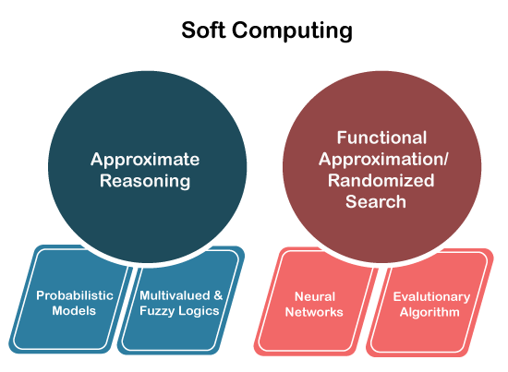
Chapter 1.1
Elements of soft computing (Cont…)
Soft computing is the use of approximate
calculations to provide imprecise
but usable solutions to
complex computational problems.

